Slide 1
UMBC
Field Information Sessions – IPT instructions
Baccalaureate Social Work Program
Office of Field Education

Slide 2
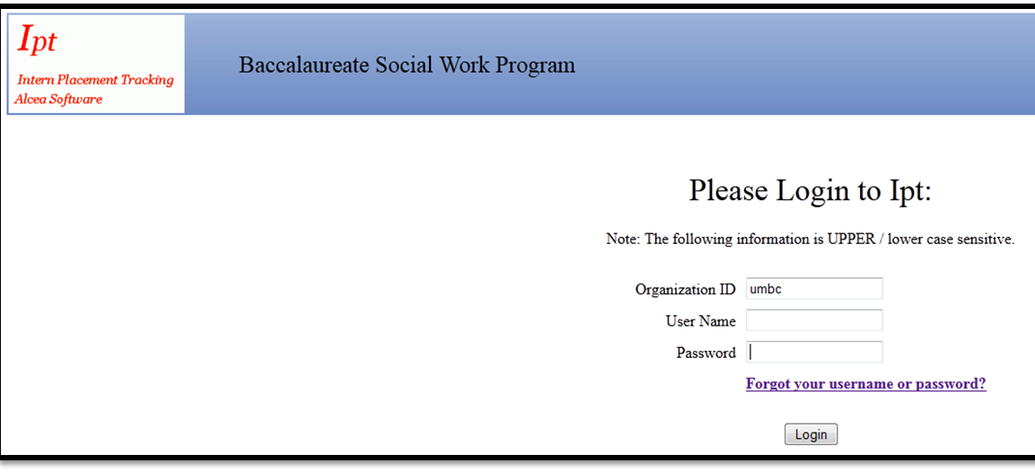
Logging into IPT
Go to www.runipt.com
Click on “Forgot your username or password?” to log in

Slide 3
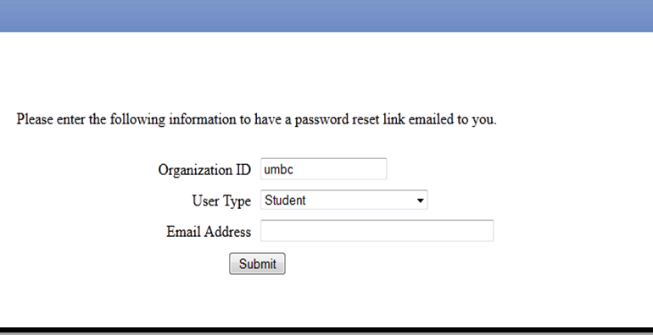
Logging in to IPT: Enter UMBC email address

Slide 4
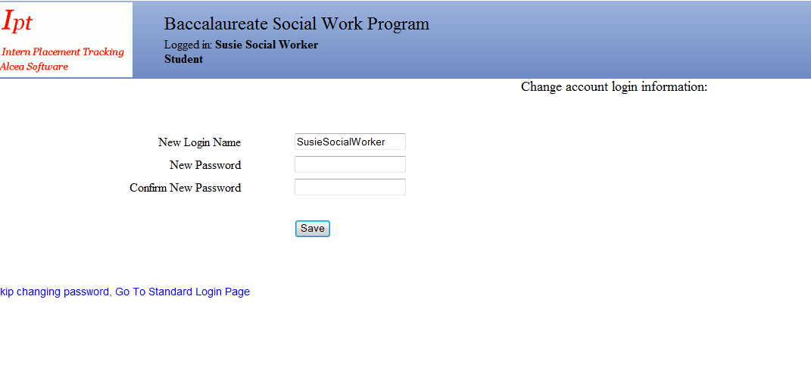
Logging in to IPT– create user name and password

Slide 5
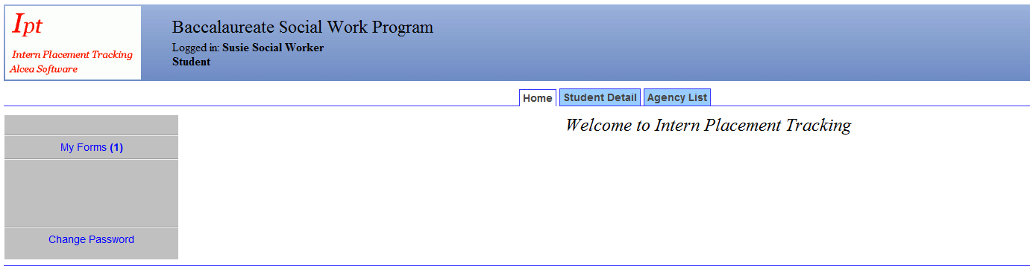
IPT Homepage

Slide 6
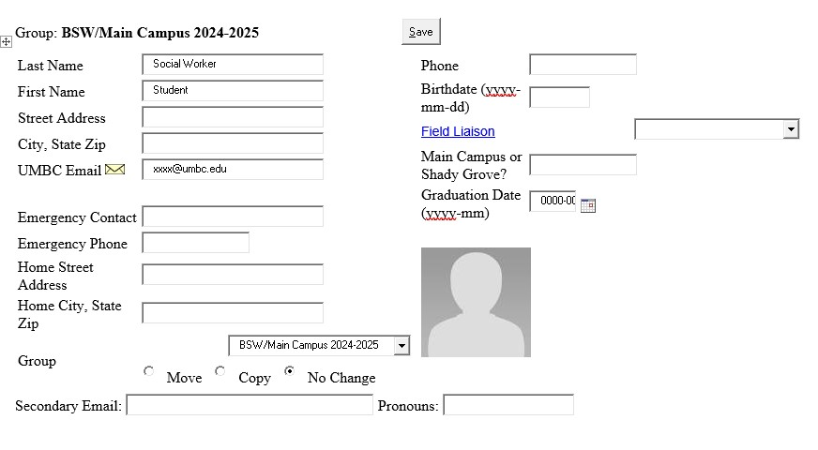
Completing Student Detail page

Slide 7
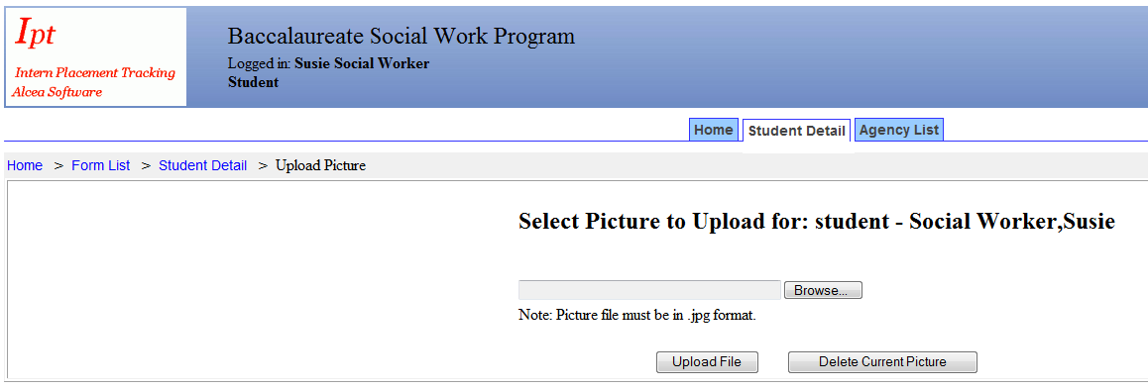
Upload picture

Slide 8
Completing Application –
Go to My Forms

Slide 9
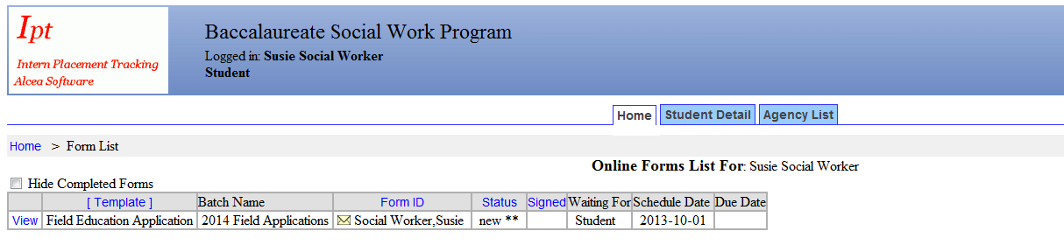

Completing the Application
To complete Field Education Application, click on “View”

Slide 10
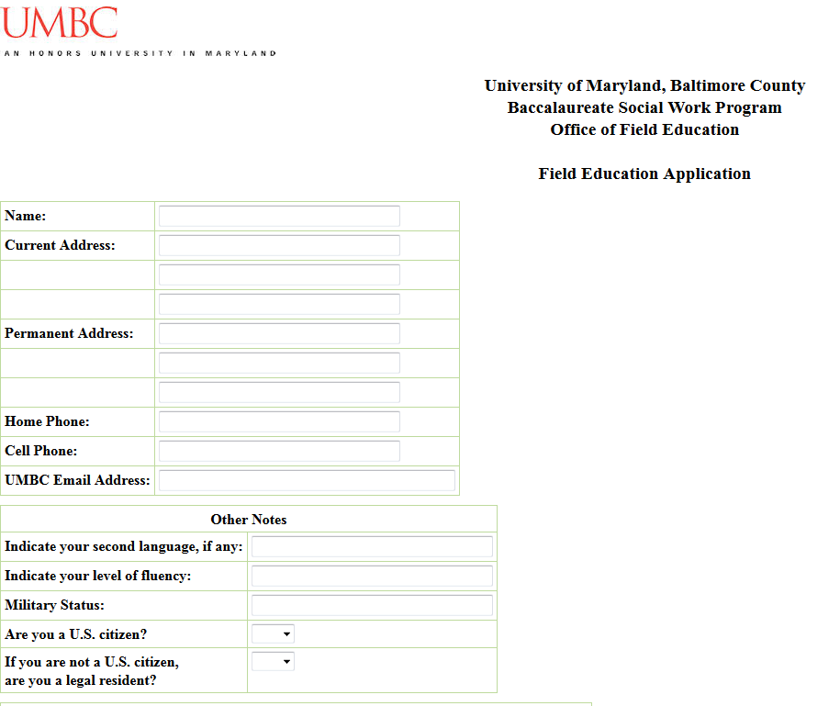
Completing the Application (cont.)

Slide 11
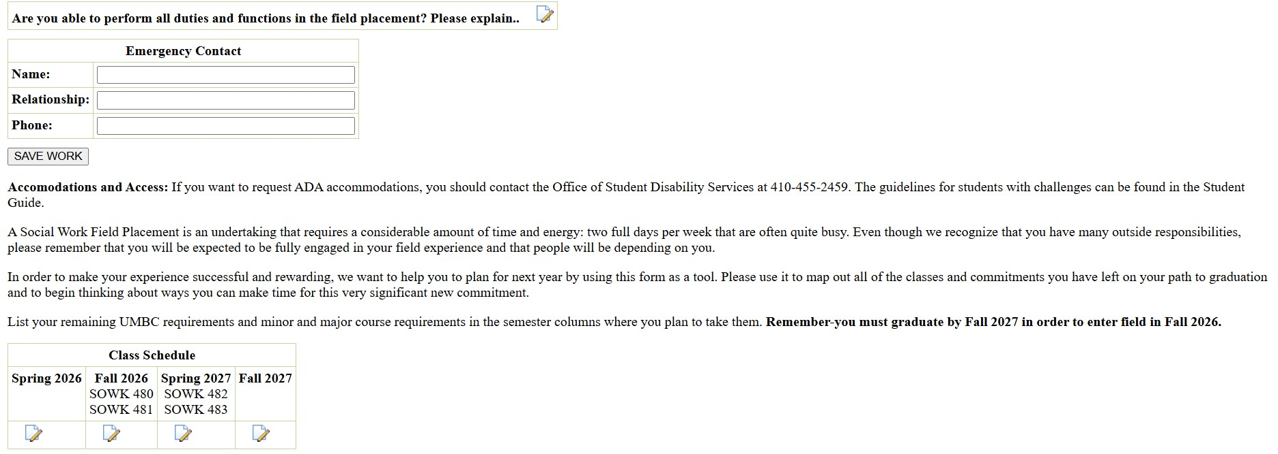
Completing the Application (cont.)

Slide 12
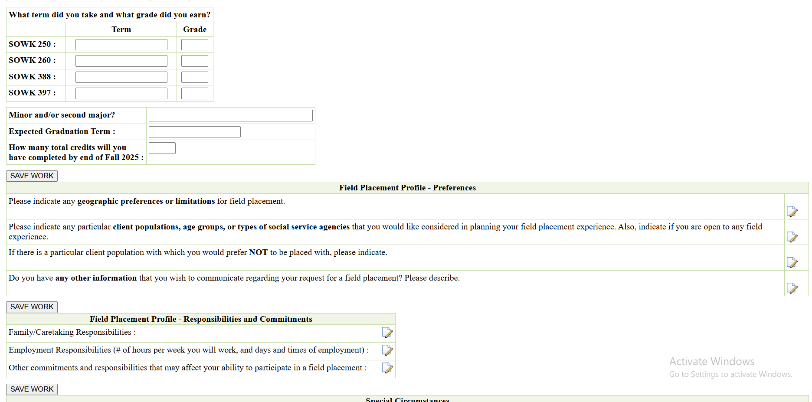
Completing the Application (cont.)
Please put N/A for current or future classes, without an assigned grade

Slide 13
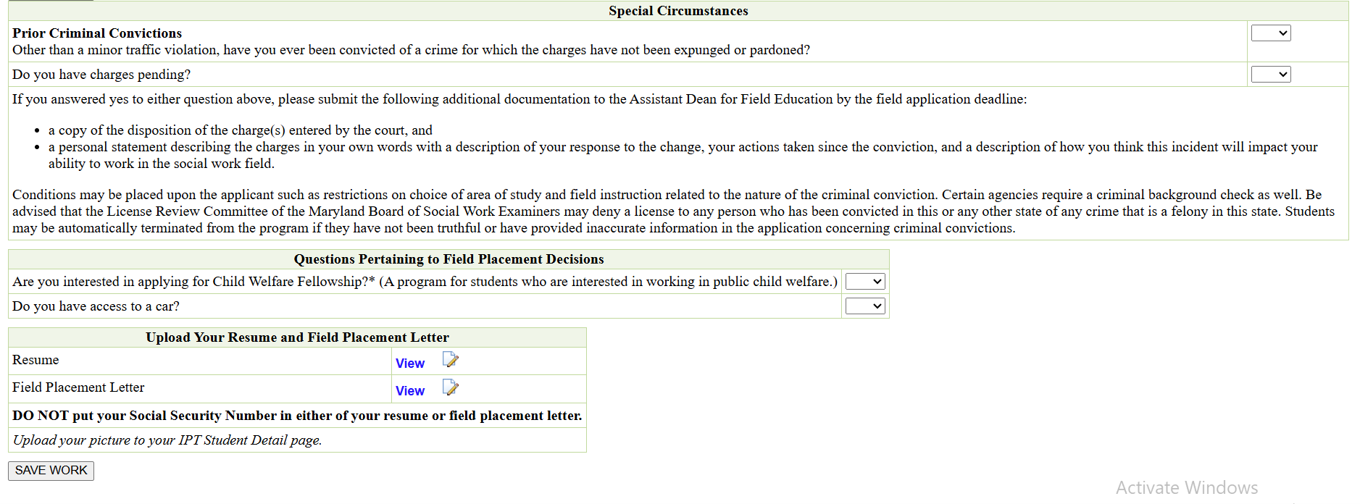
Completing the Application (cont.)

Slide 14
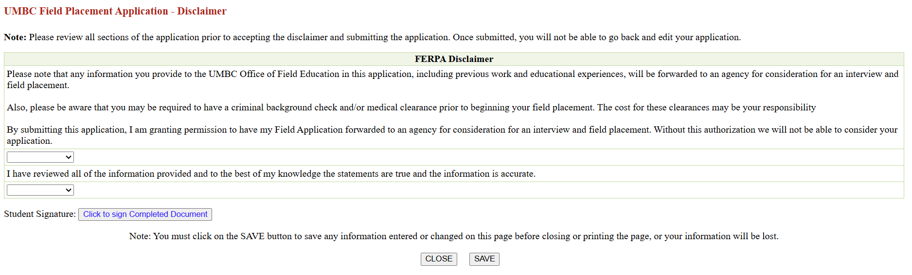
Completing the Application (cont.)

Slide 15
Further Questions?
Shady Grove students:
Contact Natalie Sanchez at natsanc@umbc.edu or 240-565-2839
Main Campus students:
Contact Adrienne Ekas at aekasm@umbc.edu or 410-455-2008
Field Education website:
https://socialwork.umbc.edu/field-education/

