Slide 1

UMBC
Field Information Sessions – IPT instructions
Baccalaureate Social Work Program
Office of Field Education

Slide 2
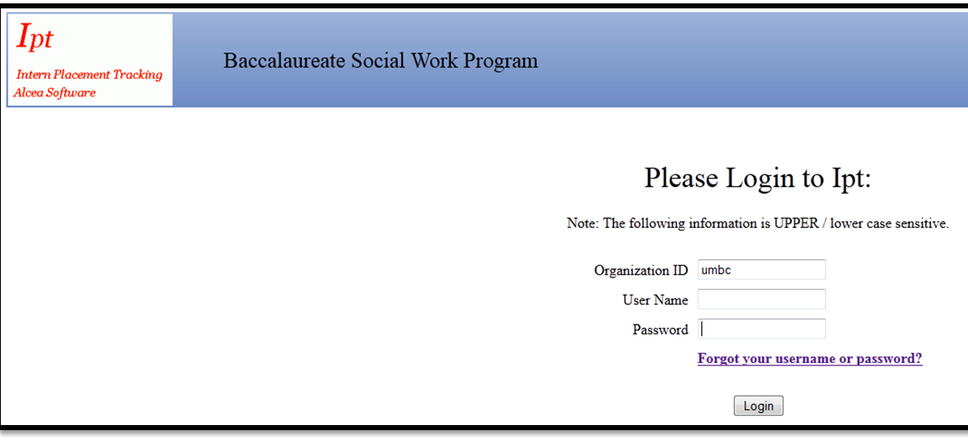
Logging into IPT
Go to www.runipt.com
Click on “Forgot your username or password?” to log in

Slide 3
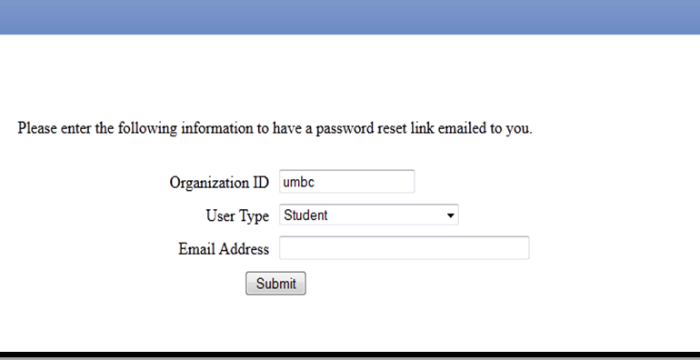
Logging in to IPT: Enter UMBC email address

Slide 4
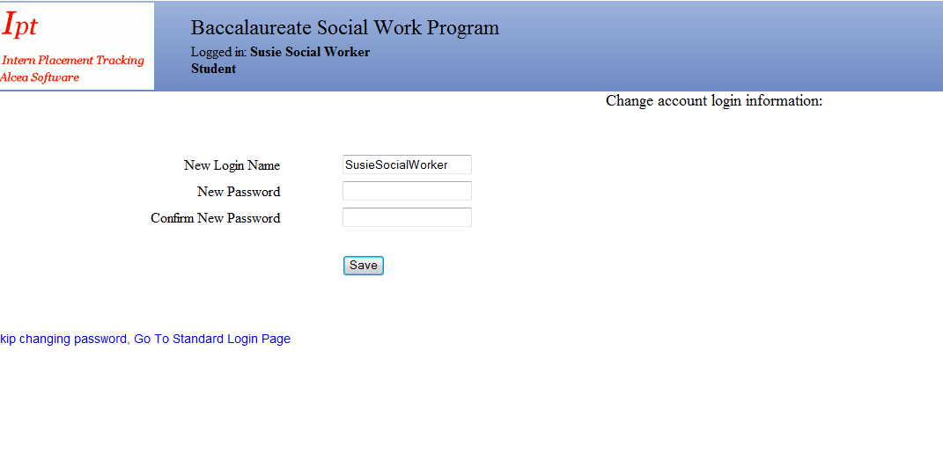
Logging in to IPT– create user name and password

Slide 5
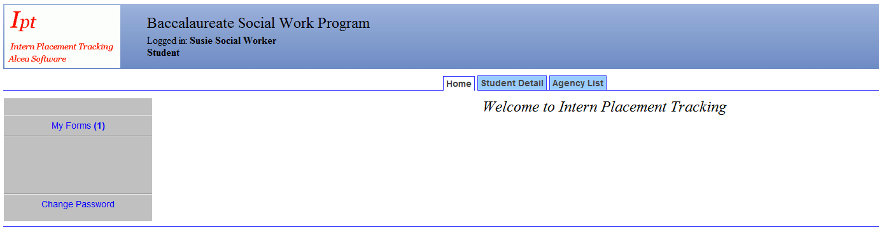
IPT Homepage

Slide 6
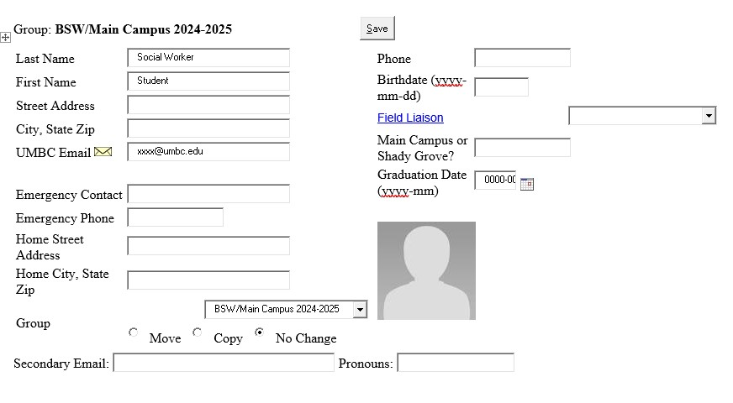
Completing Student Detail page

Slide 7
Completing Application –
Go to My Forms

Slide 8
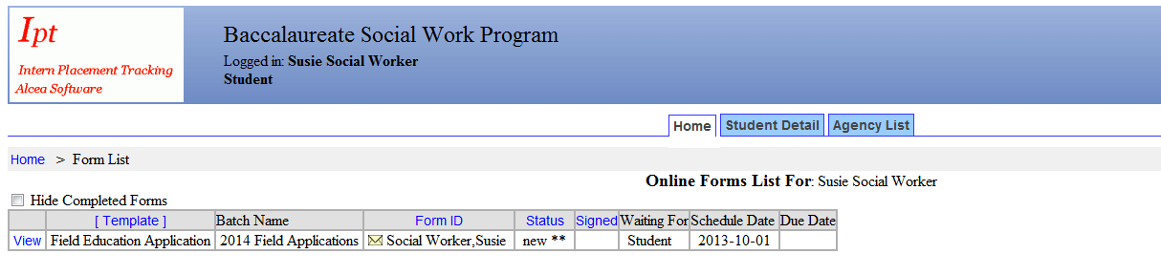

Completing the Application
To complete Field Education Application, click on “View”

Slide 9
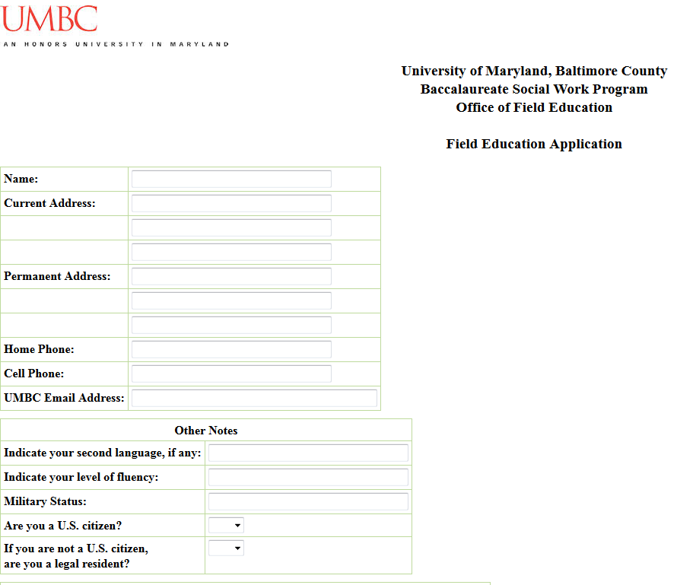
Completing the Application (cont.)

Slide 10
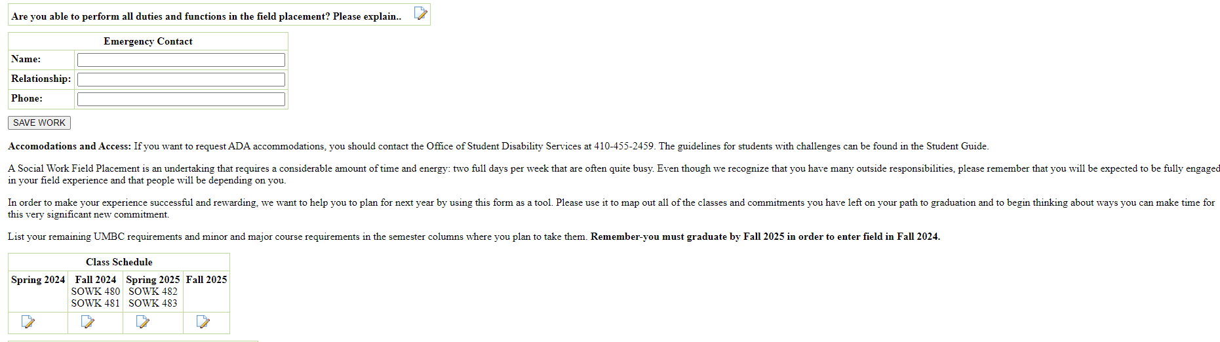
Completing the Application (cont.)

Slide 11
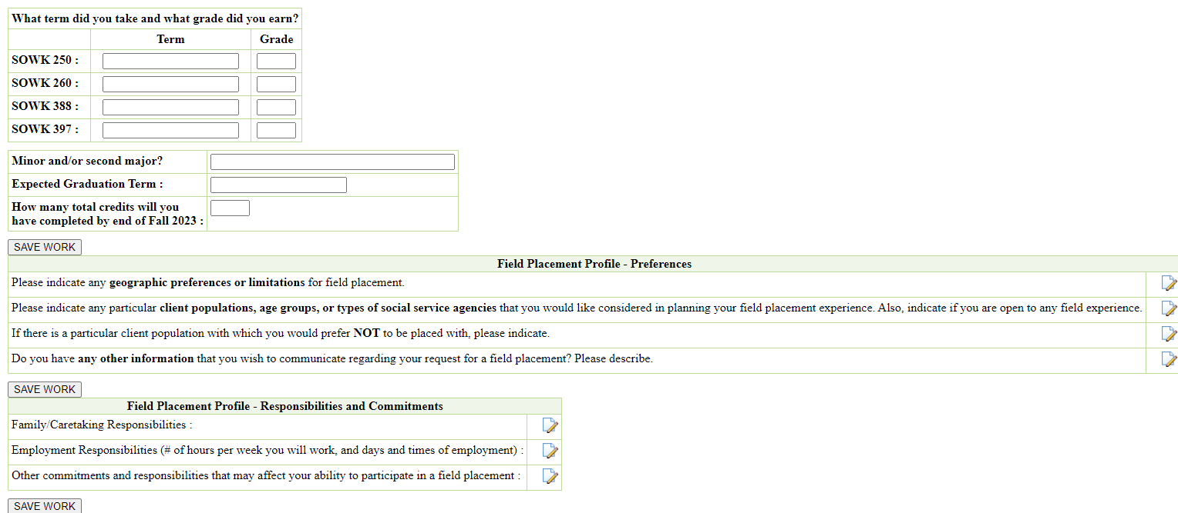
Completing the Application (cont.)
Please put N/A for current or future classes, without an assigned grade

Slide 12
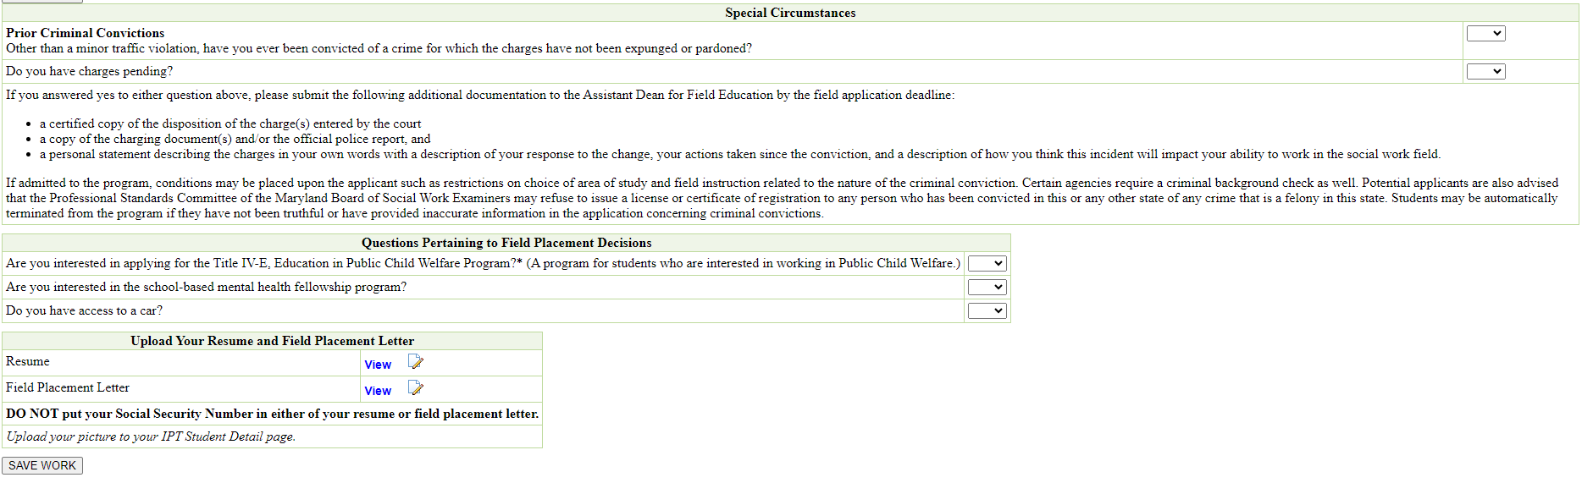
Completing the Application (cont.)

Slide 13
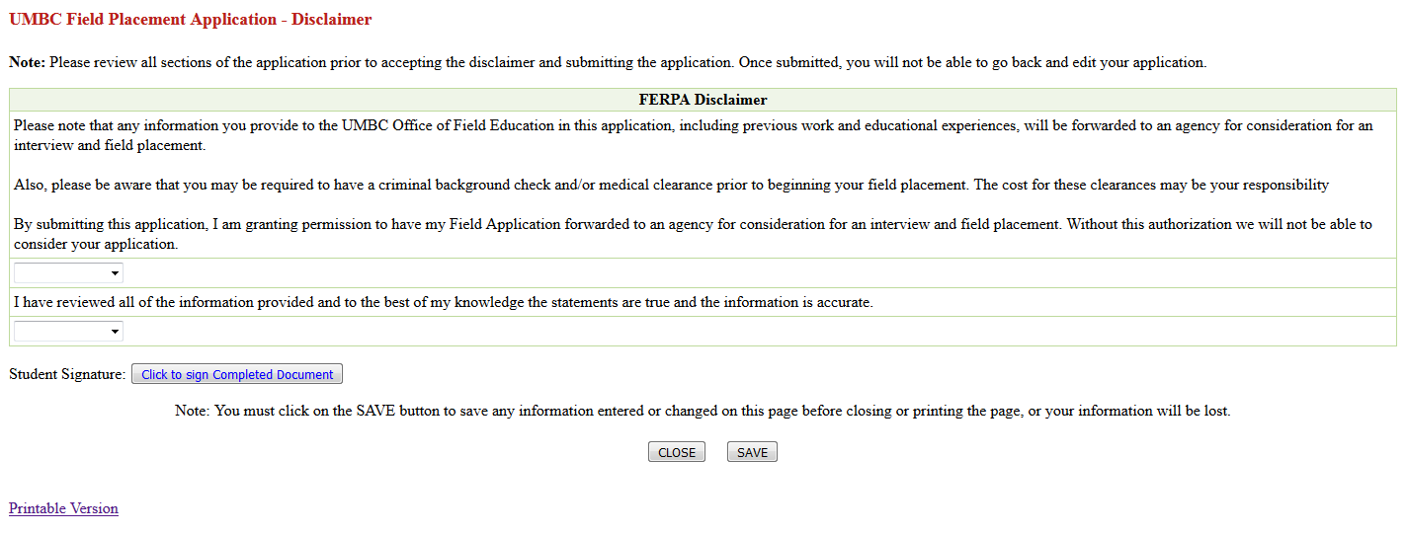
Completing the Application (cont.)

Slide 14
Further Questions?
Shady Grove students:
Contact Natalie Sanchez at natsanc@umbc.edu or 240-565-2839
Main Campus students:
Contact Adrienne Ekas at aekasm@umbc.edu
Field Education website:
https://socialwork.umbc.edu/field-education/

