Slide 1
Undergraduate Progress
Lydia Jackson-Fryer
Stephanie Anderson
Ciera Clay Valian
Jennifer Volpe
Pat Toliver
Justin Ternent
Pheng Xiong

Slide 2
Undergraduate Progress
Transfer Credit
Transfer Process and Policies
VOT and Course Descriptions
Study Abroad
Degree Audit
Mechanics of the Audit
Exceptions and Substitutions
Reviewing Audits
Graduation
Phase One – Application
Phase Two – Reviews
Phase Three - Communication

Slide 3
Glossary
TCR-Transfer Credit Report
MHEC-Maryland Higher Education Commission
USM-University System of Maryland
VOT-Verification of Transferability
TES-Transfer Evaluation System (course review system/articulation database)
ARTSYS-The articulation system for MD colleges and universities
Initial term of enrollment/Point of transfer- First term of active enrollment at UMBC
GenEd-General Education requirements

Slide 4
New!
Transfer Evaluation System (TES)
TES is the new articulation system that allows for public access to our transfer rules and the online submission and review of course descriptions.
Public View should be available before December 1st
For more information about TES please go to http://www.collegesource.com/solutions/tes
ARTSYS
ARTSYS has a new look http://artsys.usmd.edu/
We are now in the process of updating Recommended Transfer Programs (RTPs). Please contact Stephanie Anderson for assistance. These are due before November 21st

Slide 5
New!
Test Credit Review
We will be asking Articulation Coordinators to check the Appendix II for any updates that need to be made.
Montgomery College Catalog Changes
MC has changed all of the course codes as of fall 2014. Most courses have not changed content; however, many new courses have been added. We will be sending courses out for review soon.
Bachelor’s Degree from USM Schools
As of fall 2014, if a returning student has obtained a degree from a USM school prior to returning to UMBC, the remainder of the GenEds will be waived.
This is an update from the previous rule that stated GenEds were only waived if the degree was obtained prior to the first semester at UMBC.

Slide 6
Policies Updated Within the Last Year
Residency Rule
Students must complete at least 30 credits of course work at UMBC to receive a UMBC degree. Of the 30 credits in residence, 15 must be upper-level (courses numbered at the 300-level or above).
Study Abroad
As of summer 2013, Study Abroad courses are now considered inter-campus study and count toward the UMBC GPA.
Students are also allowed to study abroad in the second semester of the final year.
Just to Clarify…
Writing Intensive cannot be waived. It must be taken at UMBC; study abroad and inter-institutional coursework cannot satisfy the requirement.

Slide 7
Transfer Credit: Types of Transfer Credit
Test Scores
Advanced Placement (AP)
College-Level Exam Program (CLEP)
International Baccalaureate (IB)
College-level coursework
Two-year colleges and universities
Four-year colleges and universities
International colleges and universities (including study abroad not taken through the UMBC program)

Slide 8
Transfer Credit: Transfer Process
Receipt of OFFICIAL transcripts from previous schools in Admissions
Schools must be regionally accredited
AP & CLEP Exam Scores directly from College Board
IB Exam Scores directly from International Baccalaureate
International Credentials must be accompanied by an AACRAO foreign credential evaluation
Students do not receive a Transfer Credit Report (TCR) until they are admitted

Slide 9
Transfer Credit: Transfer Policies
Maximum credits transferred to UMBC
60 credits from Community Colleges
65 credits for Engineering Majors only
64 credits for Associate of Arts in Teaching (MD Colleges only)
90 total credits maximum
The Degree Audit advising tool will enforce these limits
Transfer credit does not factor into the UMBC GPA
Need C or better for course to transfer
Exception: Maryland Community Colleges and USM schools prior to enrollment at UMBC

Slide 10
Transfer Credit: Transfer Policies
Physical Education courses do not count towards the 120 academic credits for graduation
Courses are posted as zero credits
Writing Intensive course requirement must be fulfilled at UMBC
This includes Inter-Institutional and Study Abroad coursework
Direct equivalencies are applied to 120, upper level and major, if applicable, but student must take another WI course
A lower-level course that is equivalent to a 300 or 400 level course at UMBC will count towards the 45 upper level credit requirement
Ex: CH 203 at Montgomery College transfers as CHEM 351
Coursework will retain the level designation when a direct equivalent is not available

Slide 11
Transfer Credit: Understanding the TCR
Four types of transfer courses:
Direct equivalency
UMBC direct equivalency is listed with a course number
General Education elective credit
Lists the course discipline code, then the general education code immediately followed by a course-level designation number and a L or U designating lower-level or upper-level credit
Elective credit
Lists the course discipline code and both a course-level designation number and an L or U
TRAN
Designation used for disciplines not offered at UMBC

Slide 12
Transfer Credit: Understanding the TCR
All grades that end in T are transfer credit
Other grades used:
P=Pass with a C or better
PD=Pass with D or better (default when not specified on transcripts)
NC=No Credit
CR=Credit—Often used for labs
Quarter hour is 2/3 of a semester hour
Ex. 4 semester hours equal 2.64 quarter hours, per PeopleSoft conversion
General Education Requirement
Courses must be at least 2.5 U.S. semester hours in order to receive a General Education designation

Slide 13
Transfer Credit: Transfer Policies
If a student transfers to UMBC from a Maryland Community College with 56 or more transferable credits and a completed General Education Requirement package or an Associates Degree (AA, AS, or AAT only)
Ds count toward General Education Requirements (if applicable)
Remaining General Education Requirements are not waived
Bachelor’s Degree from a University System of Maryland institution
General Education Requirements are waived
Students are still required to satisfy Writing Intensive and PE
Ds do not count toward General Education Requirement

Slide 14
Transfer Credit: Transfer Policies
When Ds do not count
Private Maryland institutions
Non-USM institutions
Out of state institutions
International institutions
Current students transferring courses back from any institution once enrolled at UMBC

Slide 15
Transfer Credit: Transfer Policies
MHEC mandates that General Education Requirements be honored for incoming students even if a course is not a General Education Requirement at UMBC
This includes MD community colleges and USM Universities only
No mandate exists for out of state institutions
This only applies to students at the initial point of transfer
Example courses include: SPCH100, MATH106 , and Nutrition

Slide 16
Transfer Credit: Current Students
Current Students taking courses off campus
Can only receive General Education Requirements for courses that are similar to UMBC courses with General Education designations
Check the undergraduate catalog before recommending off-campus courses for students
Check Student’s General Education Requirement Group (GEP/GFR) in the degree audit
If not a General Education Requirement at UMBC, it will not transfer as a General Education Requirement
Encourage students to submit the VOT at least four weeks prior to enrolling for coursework off campus

Slide 17
Transfer Credit: Understanding the TCR
General Education and Elective Credit Examples:
ENGL 1L or ENGL L
BIOL SL_2L or BIOL SLL
CHEM S_3U or CHEM SU
TRAN SS_4U or TRAN SSU
SPAN L2012L or SPAN L201L

Slide 18
General Education Codes
AH | Arts & Humanities
AHC | Arts & Humanities/Culture
SS | Social Science
SSC | Social Science/Culture
M | Mathematics
S | Science (no lab)
SL | Science with a lab included
LAB | Lab component only
LL | GFR Language other than 201
LC | GFR Language/GEP Culture
C | Culture
EN | English Composition
PE | Physical Education
WI | Writing Intensive
L201 | 201 Level Proficiency

Slide 19
Understanding the TCR
OR

Slide 20
Transfer Credit: Test Credit
Undergraduate Catalog Appendix II
Lists the exams and scores which earn academic credit at UMBC
The current Appendix II is located at the following link: http://www.umbc.edu/catalog/2014/appendices/Appendix_II.pdf

Slide 21
Transfer Credit: Course Descriptions
Courses designated “INFO NEEDED”
Any unevaluated English Composition; Math courses below pre-calculus; courses with ambiguous titles, e.g. Imagination or In Cog Mo
Courses that can be used towards major requirements
It’s okay to have GenEd electives on the TCR and Degree Audit
Students submit a course description or syllabus with a “Course Description Review Form” to transferservicesforms@umbc.edu
Biology, Chemistry, Computer Science, Engineering, Information Systems, Physics, Mathematics, and Sociology require a syllabus to evaluate coursework
Students cannot request transferred coursework be re-evaluated for Writing Intensive
Test Credit cannot be re-evaluated

Slide 22
TES Public View
Coming in December the public view will allow online access to our domestic articulation database
International and study abroad coursework are not included in the system

Slide 23
TES Public View
Institution List
Articulation View

Slide 24
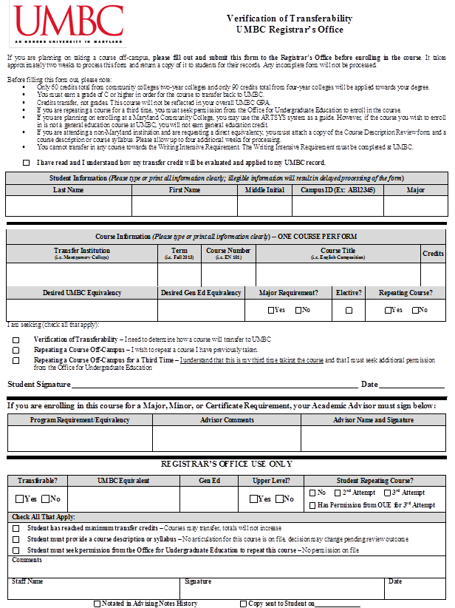
Transfer Credit: Verification of Transferability

Slide 25
Transfer Credit: Verification of Transferability
VOTs are processed within 2 weeks of receipt
Students must pick them up unless other arrangements have been made with Transfer Services
Please advise students to submit the VOT at least 4 weeks before the start of the class to allow for further processing if required, e.g. course review
Please use the new form only http://registrar.umbc.edu/files/2013/10/Verification-of-Transferability-092013.pdf

Slide 26
Study Abroad
Study Abroad coursework is still posted in the TCR
As of summer 2013 grades will no longer have a T at the end as they are under the UMBC grading basis
Ex: a grade of A will not appear as AT
Pluses (+) and minuses (-) will no longer be posted
AWAY courses will always appear In Progress on the transcripts and Degree Audit
The transcripts have a note explaining that coursework is posted under Transfer Credits at the top
Grades of D, F, and I are now posted and will affect the GPA

Slide 28
Transfer Credit: Questions
If you have questions about Transfer Credit processes or policies, please submit an RT ticket to Transfer Services

Slide 29
Degree Audit

Slide 30
Degree Audit: Mechanics of the Audit
Degree Audit is an advisement tool that helps students track their progress towards graduation.
UMBC Requirements
120 academic credits, GPA, 45 upper-level credits…
General Education Requirements
AH, SS, Mathematics…
Major(s), minor(s), and certificate(s) requirements
If incorrect, please have the student submit a Declaration of Major Form to the Registrar’s Office
Review the audit with your advisee
During registration advising
Regular advising sessions
After exception/substitution requests are completed

Slide 31
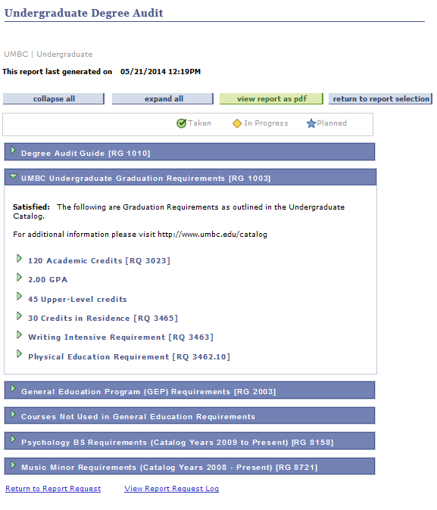

Slide 32
Degree Audit: Mechanics of the Audit
120 Academic Credits – Stops counting once a student reaches required credit amount
If a student is a dual degree student, they can submit a ticket via RT requesting 150 Academic Credits displays on their audit instead
Students earning both a B.A. and a B.S. must follow the GenEd requirements of the primary degree
Alphabetical Order – Courses populate in alphabetical order. Sometimes adjustments are needed
Cross-listed and FYS – Degree Audit reads these as a match
Manual adjustments can be made if necessary

Slide 33
Degree Audit: Mechanics of the Audit
Repeated Courses
If course is normally not repeatable, both graded and in-progress coursework will appear in the audit.
Once in-progress coursework is graded, the lowest grade will be excluded.
Be careful when assisting students with their requirements not to include in-progress repeated courses in their totals

Slide 34
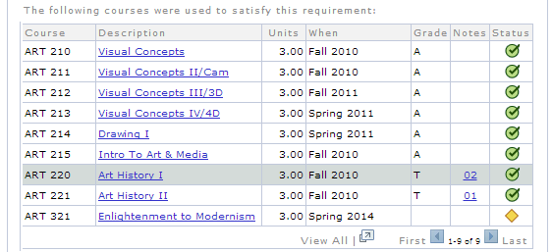
Degree Audit: Exceptions and Substitutions
Advisors may request Degree Audit exceptions and substitutions for Major, Minor, or Certificate Requirements only
UMBC Graduation or General Education Requirements must be petitioned to the Office for Undergraduate Education
Any student who requests a Major, Minor, or Certificate exception or substitution will be directed back to the department for verification
Substitutions, exceptions, and waivers will appear with notes

Slide 35
Degree Audit: Exceptions and Substitutions
Please submit all exception/substitution requests via the RT Ticketing System. Including the following information:
Student’s Name
Student’s Campus ID or Empl ID
The specific Major, Minor, or Certificate Requirement
The specific course that is being substituted

Slide 36
Degree Audit: Reviewing Audits
Degree Audit serves as a summary of a student’s record. If information is incorrect:
Incorrect Major, Minor, or Certificate – Contact the Records Team
Missing/Incorrect Transfer Credit – Contact Transfer Services
Major, Minor, and Certificate Degree Audits should be reviewed by the academic departments once a year.
Any changes to the audit (adding a course to the audit) can be submitted by a designated representative from your department to Degree Audit.
Any changes or updates to your department’s audit plan should be discussed with Jennifer Volpe

Slide 37
Degree Audit: Additional Codes

Slide 38
Degree Audit: Questions
If you have questions about Degree Audit processes or policies, please submit an RT ticket to Degree Audit

Slide 39
Graduation

Slide 40
Graduation: Phase One - Applications
All students who have 90 credits or more are notified by email to apply for graduation. The email is sent twice: after application is opened and a week before the deadline.
The email informs the students to:
Contact their department advisor(s) to verify:
Major, Minor, and/or Certificate Requirement completion
Review their Degree Audit to verify:
General Education Requirement completion
Correct Major, Minor, and/or Certificate is listed on their record
If not, they will need to contact the Registrar’s Office and complete a Change of Major form

Slide 41
Graduation: Phase One - Applications
Students who have earned 90 or more credits may file a formal online application
myUMBC > Topics > Classes and Grades > Apply for Graduation
There is no fee associated with the application
Students who are unable to apply online will have to submit a paper application available at the Registrar’s Office
Discontinued students will not be able to use the online application and must come to the Registrar’s Office to be activated in SA and given access to myUMBC

Slide 42
Graduation: Phase One - Applications
Application Dates and Deadlines
May Graduation – February 15th
Application available December 15th to February 15th
August Graduation – June 15th
Application available April 15th to June 15th
December Graduation – September 15th
Application available July 15th to September 15th
Confirmation emails are sent to all Graduation Applicants after the deadline
Late applicants must come to the Registrar’s Office and submit a Late Applicant paper application

Slide 43
Graduation: Phase Two - Reviews
After the application deadline has passed, we run internal reports via REX to receive the list of applicants
Departments have access to this list, as well
Home > Student Records and Enrollment > Degrees > Details > Graduation Application Status
Registrar’s Office prints the Plan Review Forms (Majors, Second Majors, Minors, and Certificates) and distribute them to the departments for review
For May 2013 Graduation, we have close to 1900 applicants, and have distributed approximately 3000 Plan Review Forms

Slide 44
Graduation: Phase Two - Reviews
Are Major/Minor/Certificate Requirements satisfied?
Yes – the student has already completed all the requirements and does not need any credits from the current semester, courses with incomplete grades, or transfer coursework that is not posted
Pending – the student will satisfy requirements after a successful conclusion of in-progress credit
Specify in the boxes below which courses are required and check C or better if applicable
No – the student will not satisfy the requirements even after successful completion of all the credits from the current semester and courses with incomplete grades
Specify the number of credits short (required to determine walking eligibility)

Slide 45
Graduation: Phase Two - Reviews
Is the student given any exceptions towards meeting Major requirements?
If Yes, please indicate the exceptions.
Be specific as possible so the Degree Audit Team can ensure the exception is added to the student’s audit

Slide 46
Graduation: Phase Two - Reviews
Do not change the Major and/or Minor noted on the form. This information is pulled directly from the student’s record.
To update this information, the student must submit the Change of Major form to the Registrar’s Office
A list of students who are eligible for departmental honors should be submitted via RT to the Graduation queue or emailed directly to Arthur Bezwada and Lydia Jackson-Fryer
Please be sure your name and signature are legible
Please provide a phone number so we can contact you if questions arise
Please return all Plan Review Forms within two weeks or as soon as possible. The earlier we can contact students, the earlier they can correct any issues with their status.

Slide 47
Graduation: Phase Two - Reviews
The Registrar’s Office review students for General Education Requirement completion based off of the student’s Degree Audit information
All graduation information is manually complied into an internal Access database

Slide 48
Graduation: Phase Three - Communication
One of four initial notification letters are sent to students:
Pending
Optional Major/Minor/Certificate Requirements not met
Walking-Eligible
Denied

Slide 49
Graduation: Phase Four – Posting of Degrees
Final Reviews are done after the final semester grades are posted. Grades of all applicants declared PENDING during the initial reviews will be verified to check if they have passing grades and meet all graduation requirements. After this is done, the degrees are posted by a batch process.
As per the university policy, students who have incomplete grades or no-grades will not be approved.

Slide 50
Graduation: Phase Four – Posting of Degrees
May Graduation Degrees are posted in the third week of June
August Graduation Degrees are posted in the third week of September
December Graduation Degrees are posted in the third week of January
Diplomas are ordered immediately after the degree is posted. The printers take 10-12 days to process our orders. Diplomas are mailed to the permanent address on students records.

Slide 51
Graduation: Questions
If you have questions about Graduation processes or policies, please submit an RT ticket to Graduation

